Slide 1
Basic Statistics
&
Exploratory Data Analysis

Slide 2
01
02
Case Study - Conversion Rate
Basic
Statistics

Slide 3
01
Basic Statistics

Slide 4
Descriptive Statistics
Measures of Central Tendency: Describe the typical value in a dataset.
Mean: The average of a dataset.
Median: The middle value when data is ordered.
Mode: The most frequent value in a dataset.

Slide 5
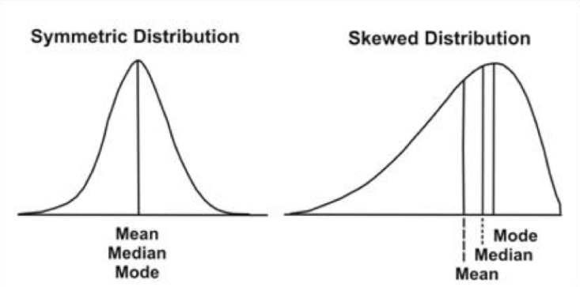

Slide 6
Descriptive Statistics
Measures of Dispersion: Explain how spread out a dataset is.
Range: The difference between the maximum and minimum values.
Standard Deviation: Measures the average distance of each data point from the mean.

Slide 7
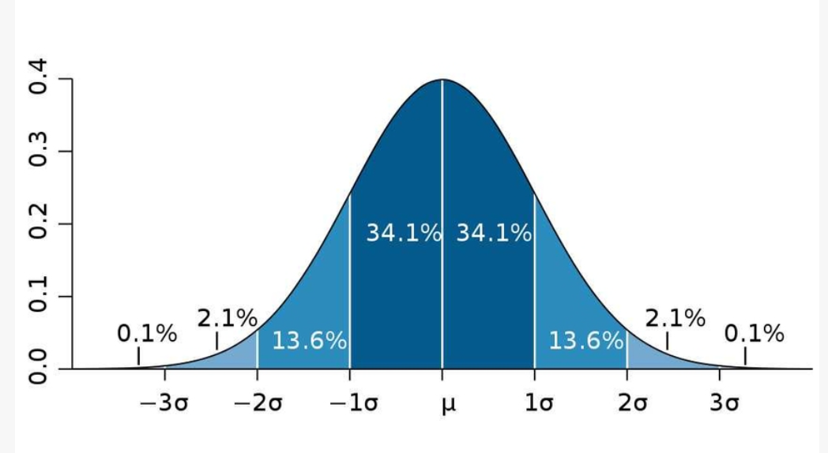

Slide 8
02
Exploratory Data Analysis (EDA)

Slide 9
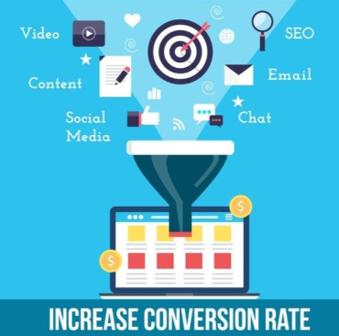
Optimizing Conversion Rate
There is a lot of data on users that visit different websites: companies find out whether they converted or not(such as buying a product) as well as some of their characteristics such as their country, the marketing channel, their age, whether they are repeat users and the number of pages visited during that session
Optimizing conversion rates is used to:
Analyze historical data to identify patterns;
Recommend changes for the product team and the marketing team to improve conversion rate.

Slide 10
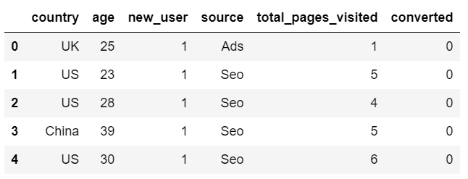
Conversion Rate Dataset

